Slide 1
Working code / software screenshots Iteration 3
Jackson Davis, Sanya Sinha, David Woolston

Slide 2
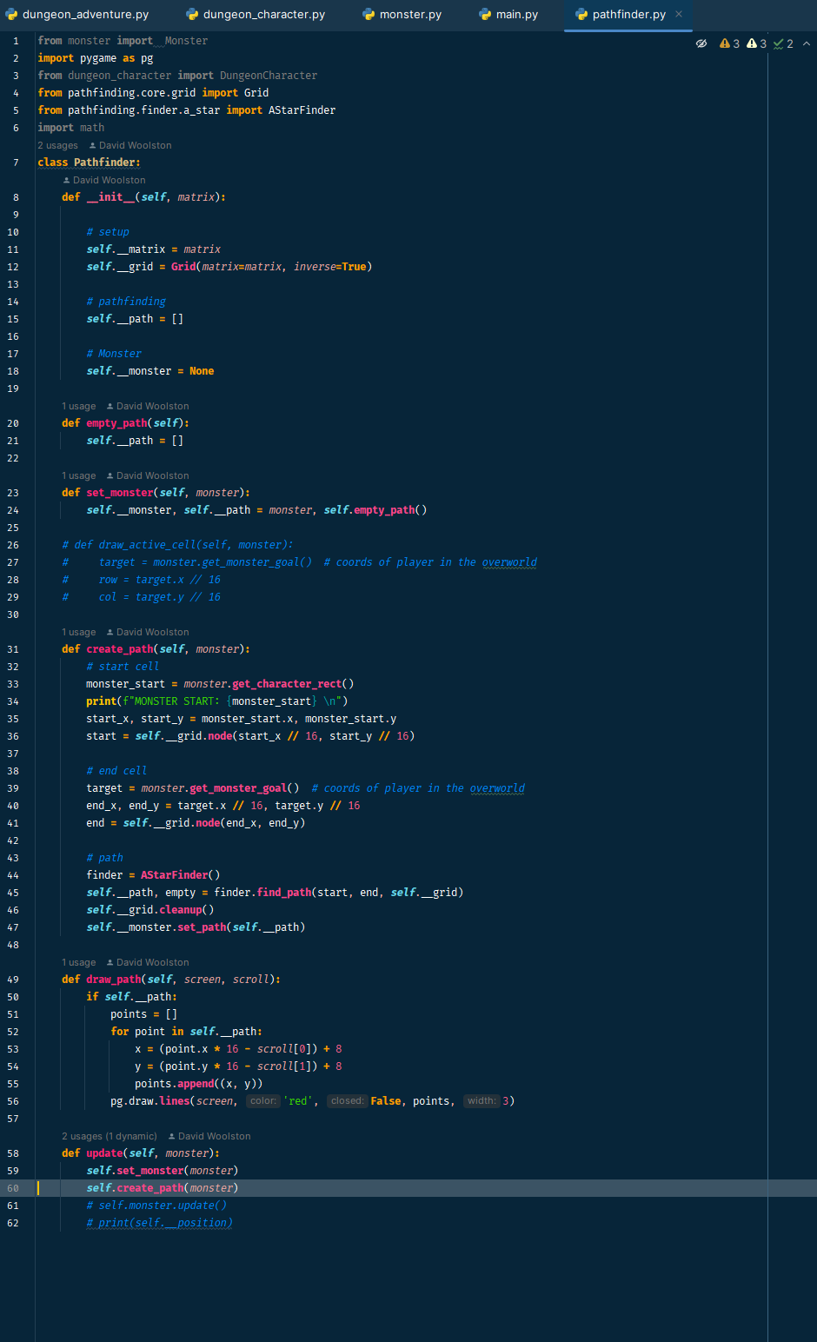
Pathfinder class code

Slide 3
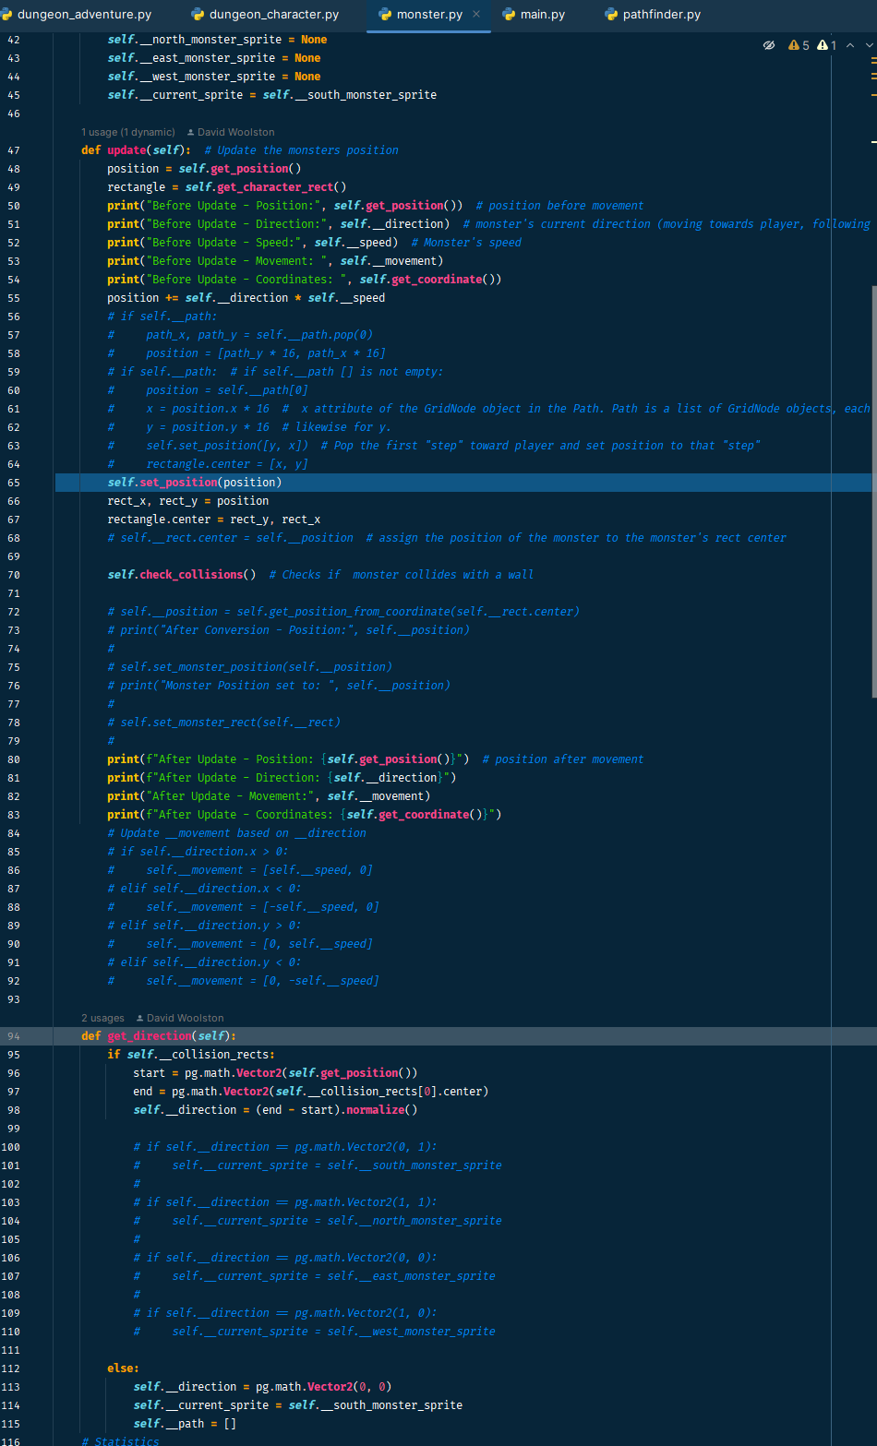
Monster pathfinding code, in progress

Slide 4
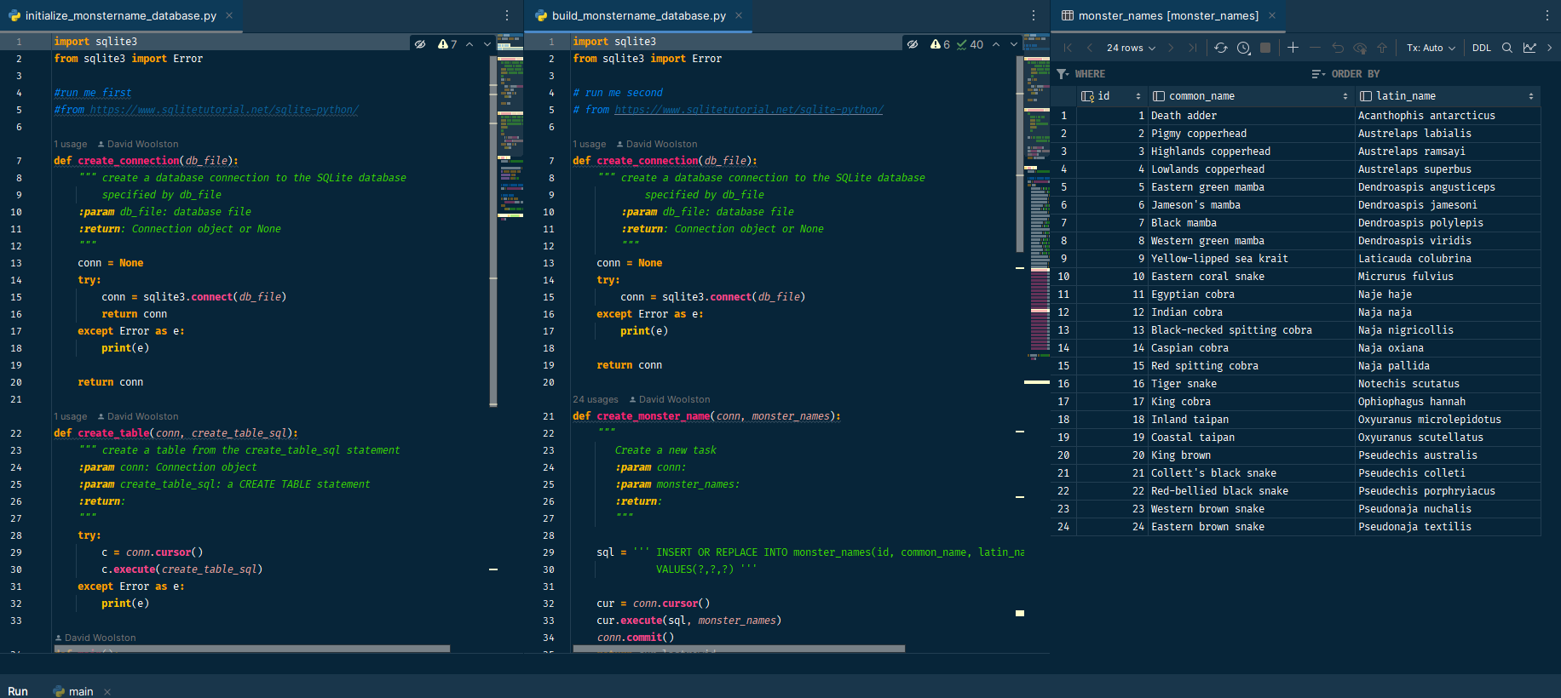
Elapid name database code

Slide 5
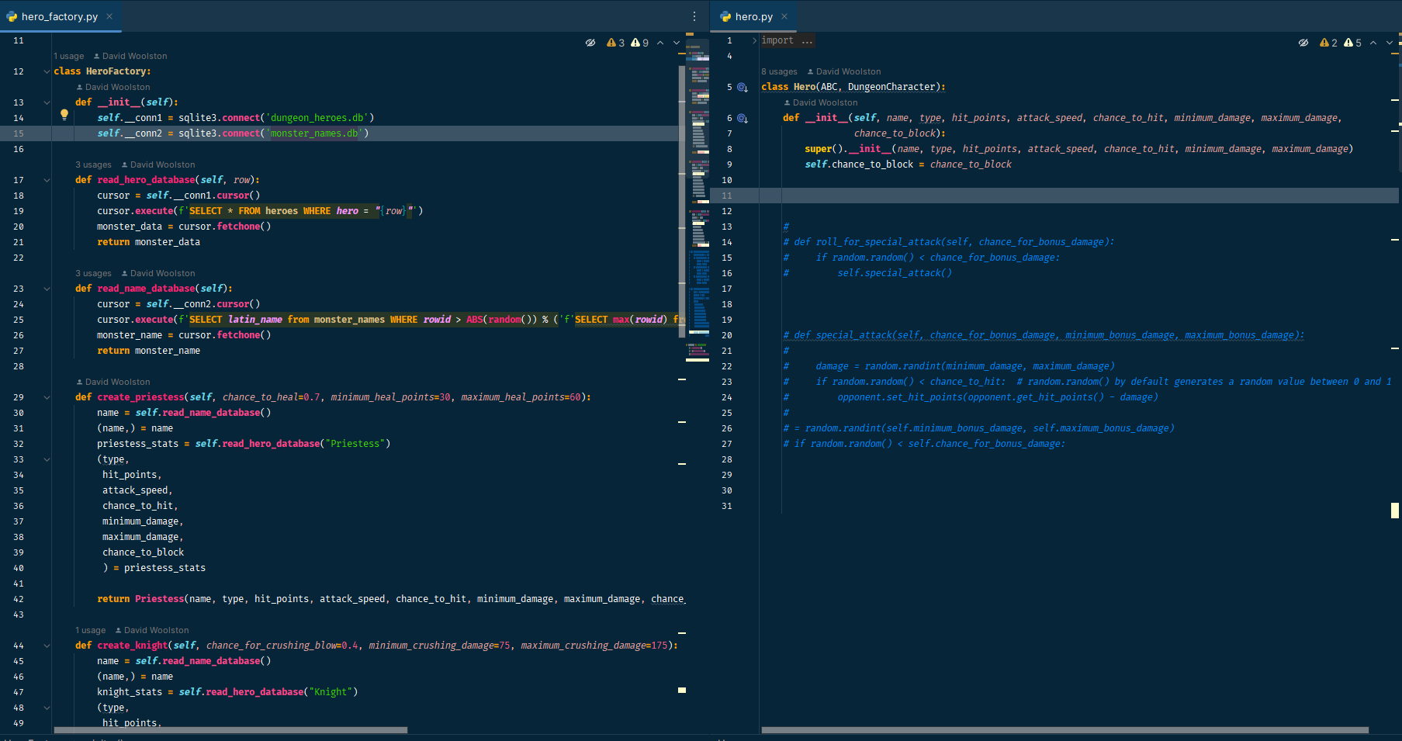
HeroFactory, Hero code

Slide 6
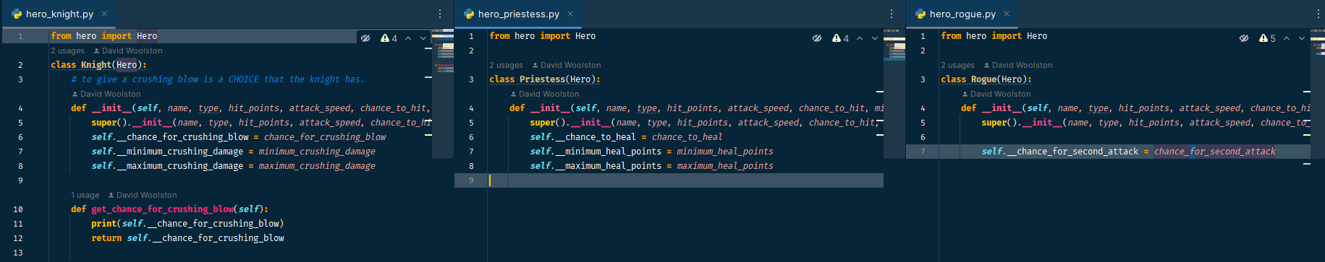
Knight, Priestess, Rogue code

Slide 7
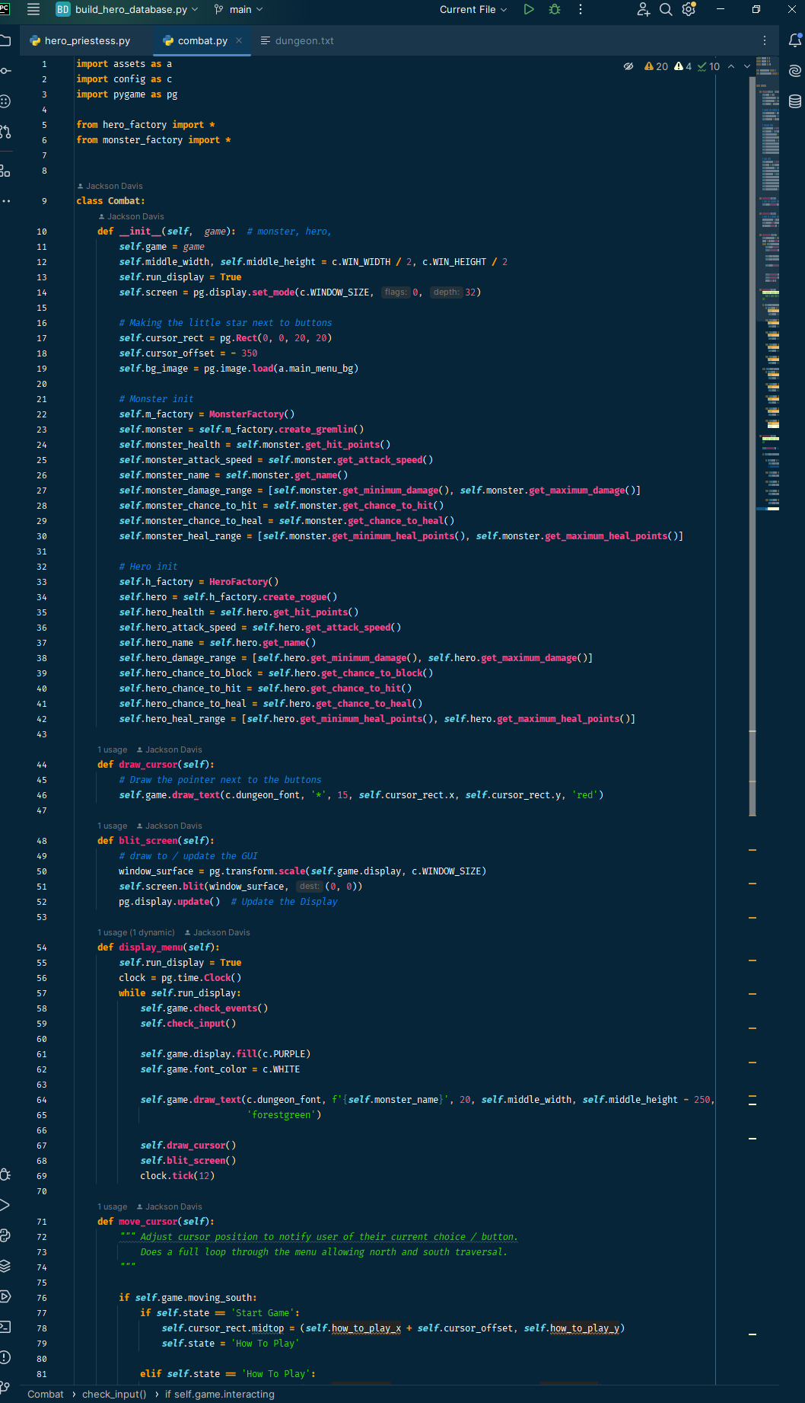
Combat

